Slide 1
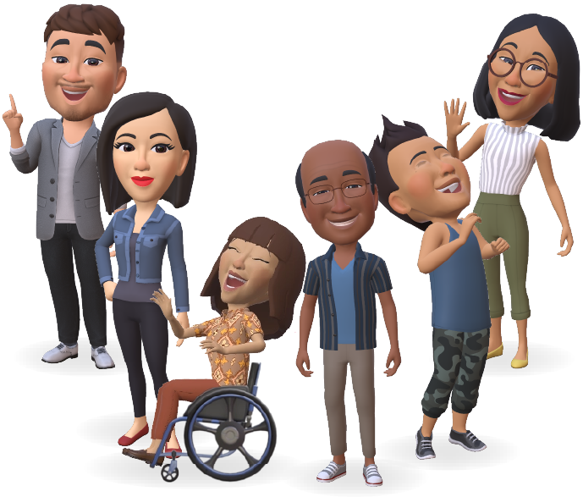
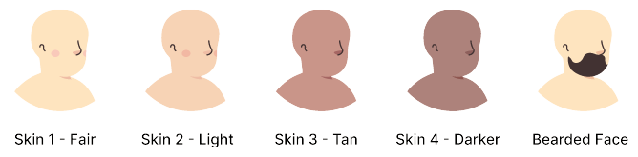
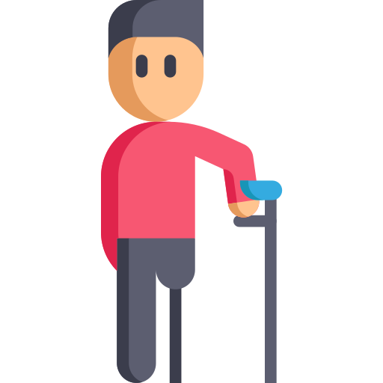
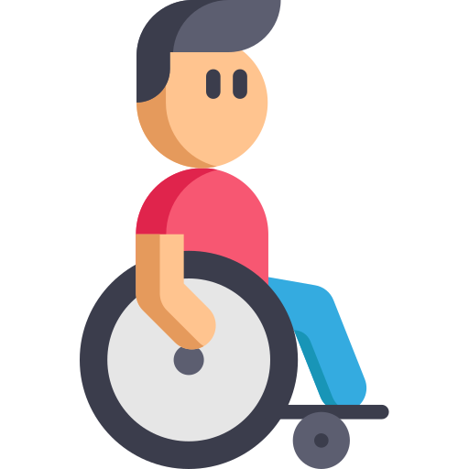
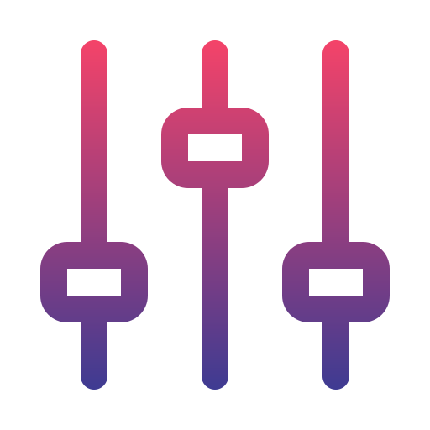
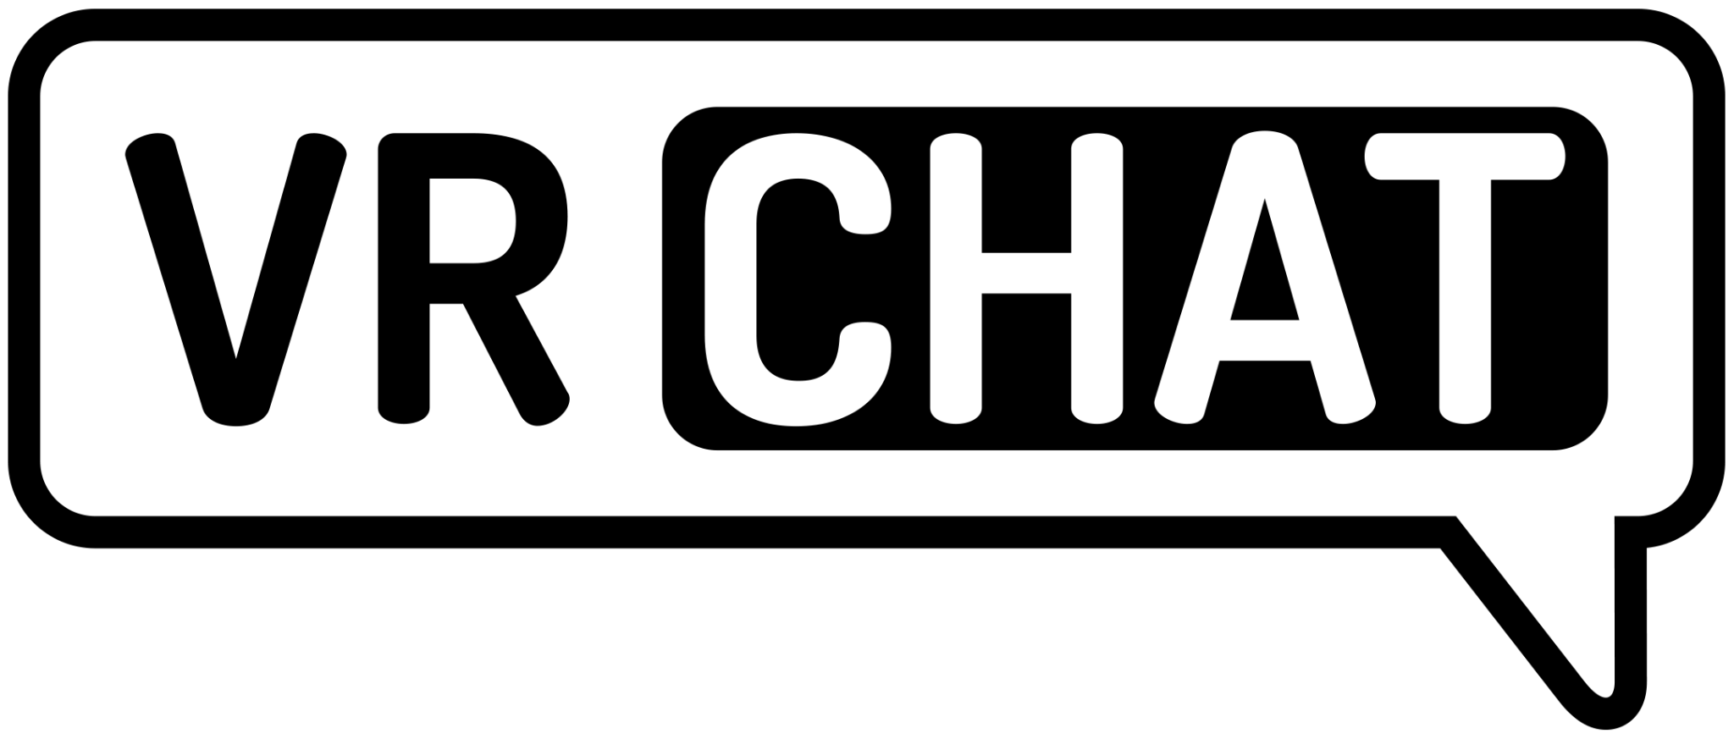
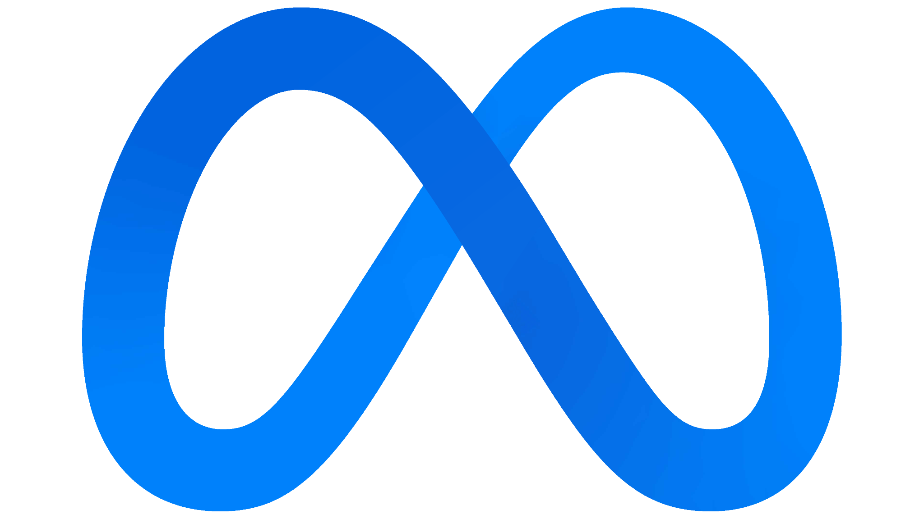
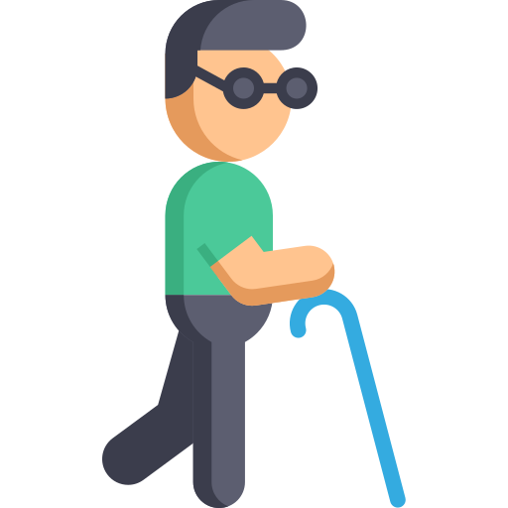
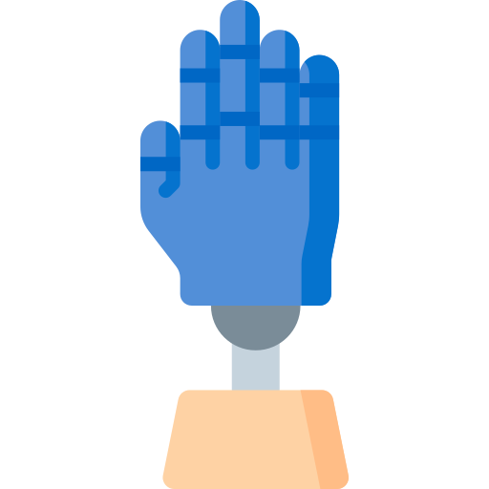


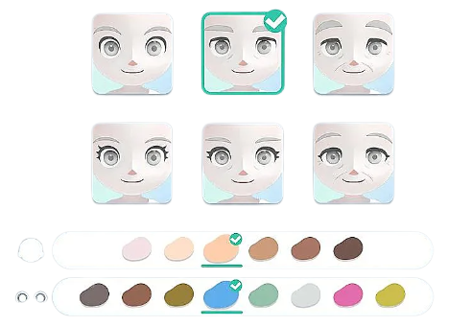
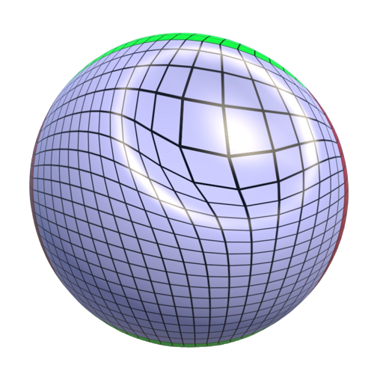
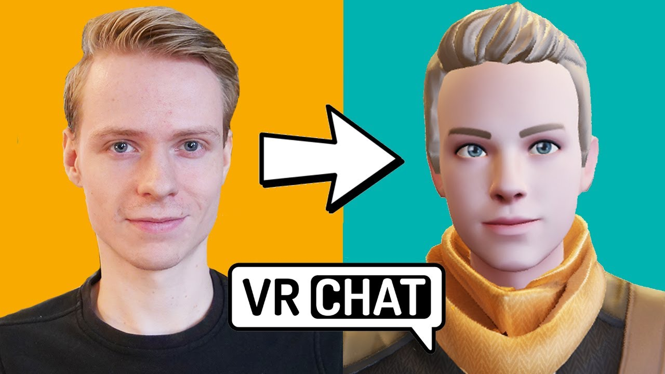
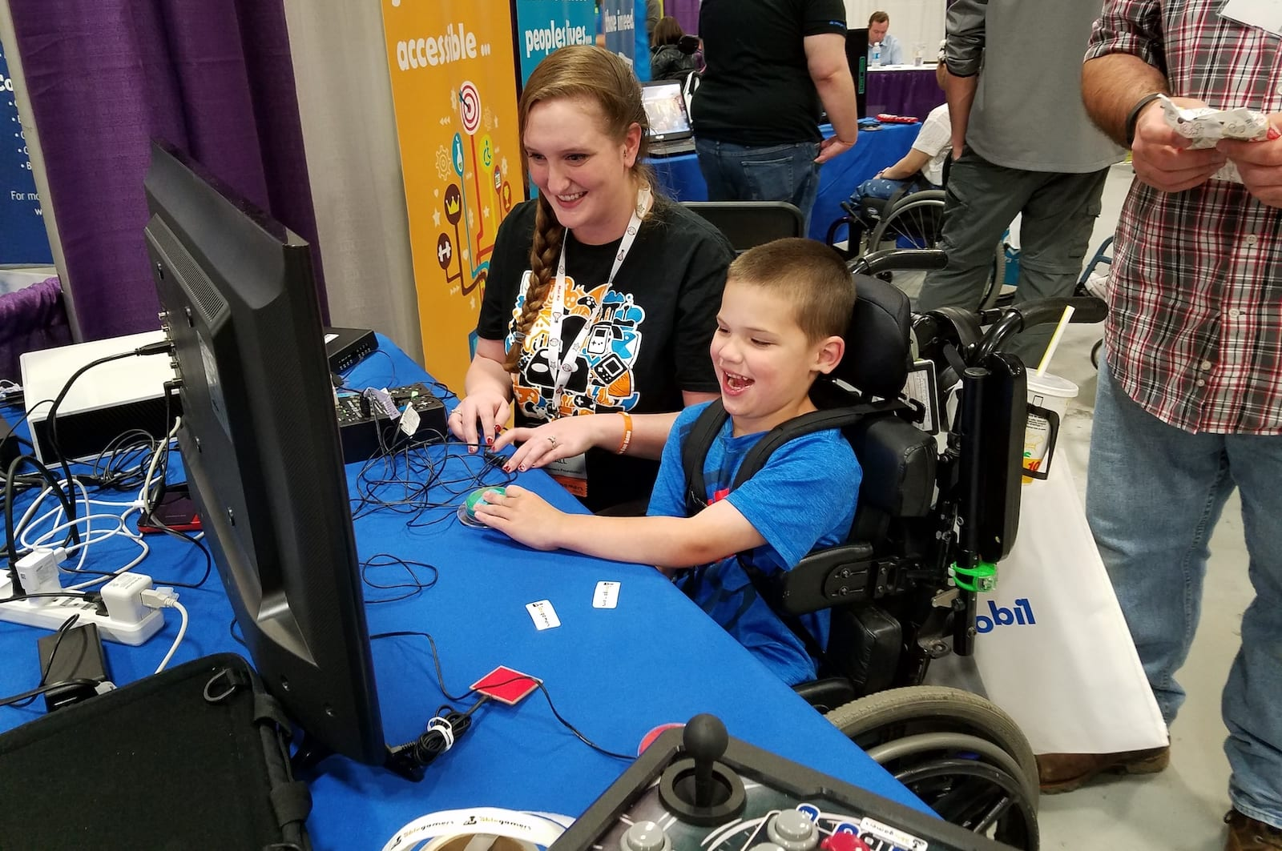

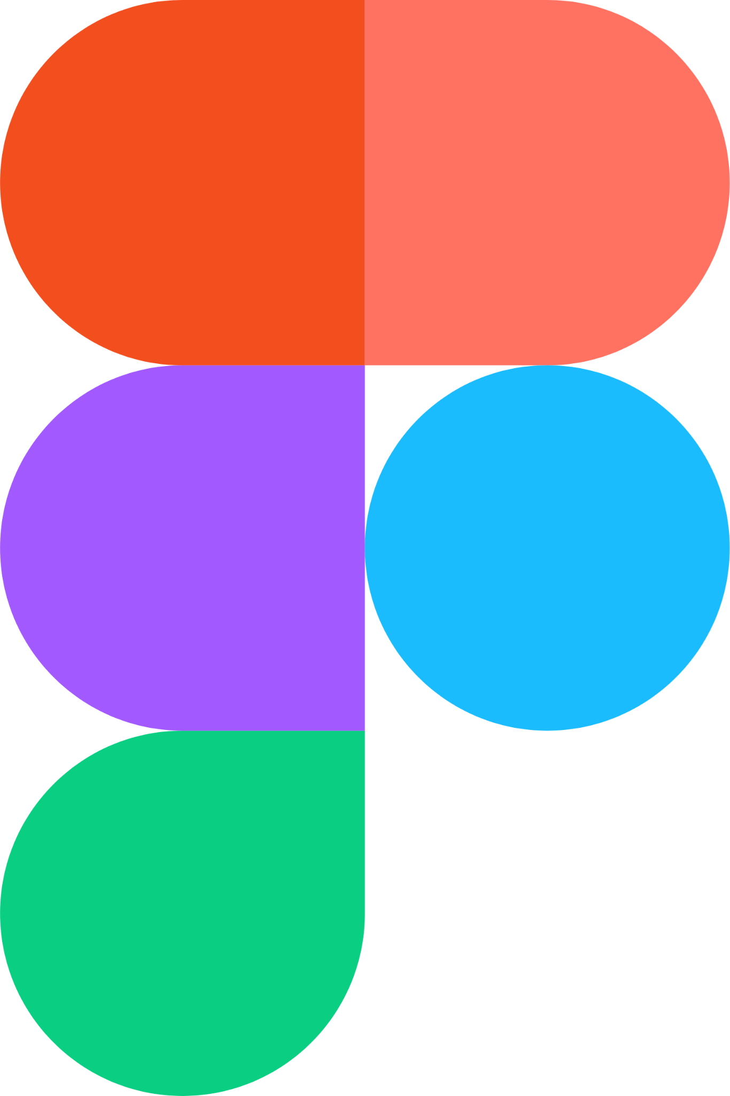

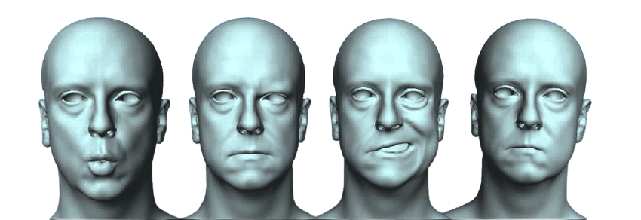
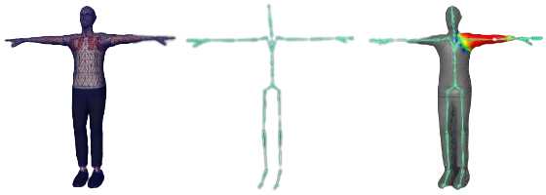
AAC: Accessible Avatar Customizer for Social Virtual Reality
Enabling users to create accessible designed avatars
Jonathan Narine, Ehren Chan
Current Customization:
Current Development in Field:
Accessibility Considerations:
+
+
Our Current Prototype:
Notes:
So let’s get the presentation started, my name is Jonathan Narine *Ehren says name* and this is a 3 minute thesis presentation on our Accessible Avatar Customizer or AAC for short. With vr technology quickly advancing, the need for accessibility is present in pretty much every aspect of the software. Over 2 million canadian gamers with disabilities, many are active in every aspect of vr, trying to interact with the amazing software. However, there is still a heavily under addressed issue in VR and other games which continues to be ignored by even large corporations with the resources to do something about it. Accessibility regarding the design of Avatars. Now what exactly does accessible avatars mean. Well, Personally, I am a partial left amputee, who has never really been able to create an avatar that looks like me. I also have glasses and a skin tone that usually between two different presets. Accessible Avatars and the lack of it describes the lack of true customization for avatar creation and consideration for those whose bodies don’t fit the norm. And this especially affects VR and social VR in particular. Where there is emphasis on the sense of immersion and on reflecting your personal identity for those to see.
So we decided to change that with the AAC, where we plan to create a customizer that takes the current customization that occurs in most game and adding accessibility consideration. This would include creating custom presets, multiple accessories and facial features that stack on each other, sculpting unique feature in free form editing and importing body parts and custom textures. Like a lot of accessibility features, this would allow those with disabilities to feel included and able to enjoy the experience. But also like a lot of accessibility features, it would also allow the typical user to even further customize their character and make unique creation easily accessible. Now for what’s going on in the industry and next steps , ehren will talk more on that

Slide 2
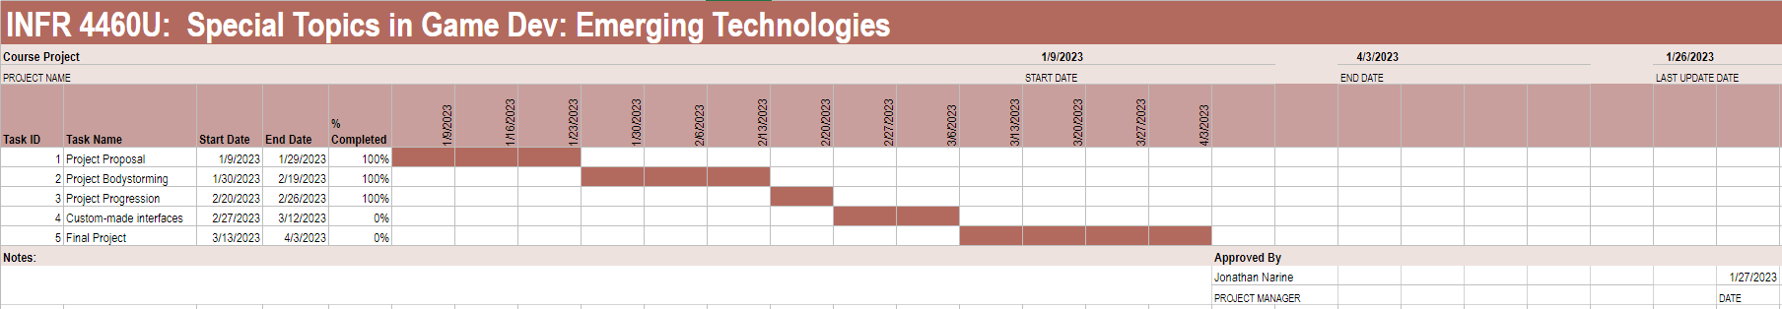
Appendices
https://www.accessibility.com/blog/facebook-rolls-out-new-avatar-options-for-people-with-disabilities
https://www.kalloctech.com/design_avatar.jsp
https://www.eurogamer.net/vrchat-bans-all-mods-leaving-disabled-players-and-community-feeling-abandoned
https://www.cbc.ca/radio/people-with-disabilities-hobbies-1.6752548
https://assetstore.unity.com/packages/3d/characters/uma-2-unity-multipurpose-avatar-35611
Notes:
Figma Link: https://www.figma.com/file/p6LJek0KTMTI8oRs1FA38B/Rough-Prototype?node-id=0%3A1&t=fFX7gdg8hmNe6x6m-0
Mozilla Link: https://hubs.mozilla.com/AMHfMpP

